Slide 1

TAIBAH UNIVERSITY
Faculty of Science
Department of Math.
جامعة طيبة
كلية العلوم
قسم الرياضيات
Probability and Statistics for Engineers
STAT 301
Second Semester 1432/1433
Teacher : Dr. Osama Hosam

Slide 2
Probability
Chapter 2: Lesson 2

Slide 3
2.4. Probability of an Event: Text book page 48
· To every point (outcome) in the sample space of an experiment S, we assign a weight (or probability), ranging from 0 to 1, such that the sum of all weights (probabilities) equals 1.
· The weight (or probability) of an outcome measures its likelihood (chance) of occurrence.
· To find the probability of an event A, we sum all probabilities of the sample points in A. This sum is called the probability of the event A and is denoted by P(A).

Slide 4
Definition 2.8:
The probability of an event A is the sum of the weights (probabilities) of all sample points in A. Therefore,
1)
2)
3)

Slide 5
Example 2.22:
A balanced coin is tossed twice. What is the probability that at least one head occurs?
Solution:
S = {HH, HT, TH, TT}
A = {at least one head occurs}= {HH, HT, TH}
Since the coin is balanced, the outcomes are equally likely; i.e., all outcomes have the same weight or probability.

Slide 6
Outcome
Weight (Probability)
4w =1 ⇔ w =1/4 = 0.25
P(HH)=P(HT)=P(TH)=P(TT)=0.25
HH
HT
TH
TT
P(HH) = w
P(HT) = w
P(TH) = w
P(TT) = w
sum
4w=1

Slide 7
The probability that at least one head occurs is:
P(A) = P({at least one head occurs})=P({HH, HT, TH})
= P(HH) + P(HT) + P(TH)
= 0.25+0.25+0.25
= 0.75

Slide 8
Theorem 2.9:
If an experiment has n(S)=N equally likely different outcomes, then the probability of the event A is:

Slide 9
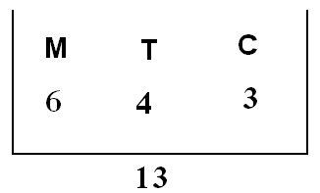
Example 2.25:
A mixture of candies consists of 6 mints, 4 toffees, and 3 chocolates. If a person makes a random selection of one of these candies, find the probability of getting:
(a) a mint
(b) a toffee or chocolate.
Solution:
Define the following events:
M = {getting a mint}
T = {getting a toffee}
C = {getting a chocolate}

Slide 10
Experiment: selecting a candy at random from 13 candies
n(S) = no. of outcomes of the experiment of selecting a candy.
= no. of different ways of selecting a candy from 13 candies.

Slide 11
The outcomes of the experiment are equally likely because the selection is made at random.
(a) M = {getting a mint}
n(M) = no. of different ways of selecting
a mint candy from 6 mint candies
P(M )= P({getting a mint})=

Slide 12
(b) T∪C = {getting a toffee or chocolate}
n(T∪C) = no. of different ways of
selecting a toffee or a chocolate
candy
= no. of different ways of selecting
a toffee candy + no. of different
ways of selecting chocolate
candy

Slide 13
= no. of different ways of
selecting a candy from 7 candies
P(T∪C )= P({getting a toffee or chocolate})
=

Slide 14
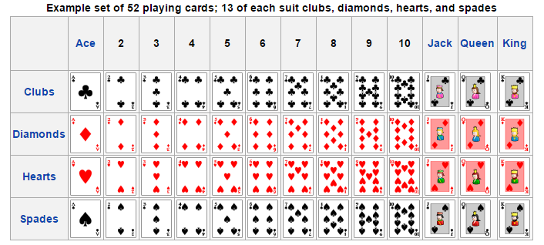
Example 2.26:
In a poker hand consisting of 5 cards, find the probability of holding 2 aces and 3 jacks.

Slide 15
Example 2.26:
In a poker hand consisting of 5 cards, find the probability of holding 2 aces and 3 jacks.
Solution:
Experiment: selecting 5 cards from 52 cards.
n(S) = no. of outcomes of the experiment of selecting 5 cards from 52 cards.

Slide 16
The outcomes of the experiment are equally likely because the selection is made at random.
Define the event A = {holding 2 aces and 3 jacks}
n(A) = no. of ways of selecting 2 aces and 3
jacks
= (no. of ways of selecting 2 aces) × (no.
of ways of selecting 3 jacks)
= (no. of ways of selecting 2 aces from 4
aces) × (no. of ways of selecting 3
jacks from 4 jacks)

Slide 17
×
×
P(A )= P({holding 2 aces and 3 jacks })

Slide 18
Additive Rule

Slide 19
2.5 Additive Rules:
Theorem 2.10:
If A and B are any two events, then:
P(A∪B)= P(A) + P(B) − P(A∩B)
Corollary 1:
If A and B are mutually exclusive (disjoint) events, then:
P(A∪B)= P(A) + P(B)

Slide 20
Corollary 2:
If A₁, A₂, …, A_{n} are n mutually exclusive (disjoint) events, then:
P(A₁∪ A₂ ∪… ∪A _{n})= P(A₁) + P(A₂) +… + P(A_{n})

Slide 21
Corollary 3:
If A₁, A₂, …, A_{n} is a partition of sample space S, then
P(A₁ ∪ A₂ ∪ ….∪ A_{n}) =
P(A₁) + P(A₂) …+ P(A_{n}) = P(S) = 1.

Slide 22
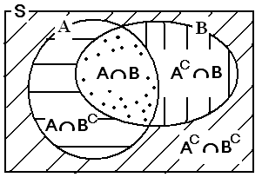
Note: Two event Problems:
Total area= P(S)=1* In Venn diagrams, consider the probability of an event A as
the area of the region corresponding to the event A.
* Total area= P(S)=1
Total area= P(S)=1

Slide 23
* Examples:
P(A)= P(A∩B)+ P(A∩B^{C})
P(A∪B)= P(A) + P(A^{C}∩B)
P(A∪B)= P(A) + P(B) − P(A∩B)
P(A∩B^{C})= P(A) − P(A∩B)
P(A^{C}∩B^{C})= 1 − P(A∪B)
etc.,

Slide 24
Example 2.27:
The probability that Paula passes Mathematics is 2/3, and the probability that she passes English is 4/9. If the probability that she passes both courses is 1/4, what is the probability that she will:
(a) pass at least one course?
(b) pass Mathematics and fail English?
(c) fail both courses?

Slide 25
Solution:
Define the events:
M={Paula passes Mathematics}
E={Paula passes English}
We know that P(M)=2/3, P(E)=4/9, and P(M∩E)=1/4.
(a) Probability of passing at least one course is:
P(M∪E)= P(M) + P(E) − P(M∩E)

Slide 26
(b) Probability of passing Mathematics and failing English is:
P(M∩E^{C})= P(M) − P(M∩E)
(c) Probability of failing both courses is:
P(M^{C}∩E^{C})= 1 − P(M∪E)

Slide 27
Theorem 2.12:
If A and A^{C} are complementary events, then:
P(A) + P(A^{C}) = 1 ⇔ P(A^{C}) = 1 − P(A)
Proof: Since A U A^{C} = S and the sets A and A^{C} are disjoint, then
1 = P(S) = P(A U A^{C}) = P(A) + P(A^{C}).

Slide 28
Example 2.31 If the probabilities that an automobile mechanic will service 3, 4, 5, 6, 7, or 8 or more cars on any given workday are, respectively, 0.12, 0.19, 0.28, 0.24, 0.10, and 0.07, what is the probability that he will service at least 5 cars on his next day at work?

Slide 29
Solution: Let E be the event that at least 5 cars are serviced. Now, P(E) = 1 — P(E^{c}),
where E^{c} is the event that fewer than 5 cars are serviced. Since
P(E^{c}) = 0.12+ 0.19 = 0.31,
it follows from Theorem 2.12 that
P(E) = 1 - 0.31 = 0.69.

Slide 30
Example 2.32 Suppose the manufacturer specifications of the length of a certain type of computer cable are 2000 ± 10 millimeters. In this industry, it is known that small cable is just as likely to be defective (not meeting specifications) as large cable. That is, the probability of randomly producing a cable with length exceeding 2010 millimeters

Slide 31
is equal to the probability of producing a cable with length smaller than 1990 millimeters. The probability that the production procedure meets specifications is known to be 0.99.
(a) What is the probability that a cable selected randomly is too large?
(b) What is the probability that a randomly selected cable is larger than 1990
millimeters?

Slide 32
Solution: Let M be the event that a cable meets specifications. Let S and L be the events
that the cable is too small and too large, respectively. Then
(a) P(M) = 0.99 and P(S) = P(L) = = 0.005.
(b) Denoting by X the length of a randomly selected cable, we have

Slide 33
P(1990 < X < 2010) = P(M) = 0.99.
Since P(X > 2010) = P(L) = 0.005
then
P(X > 1990) = P(M) + P(L) = 0.995.
This also can be solved by using Theorem 2.12:
P(X > 1990) + P(X < 1990) = 1.
Thus, P(X > 1990) = 1 – P(S)
= 1 - 0.005 = 0.995.

Slide 34
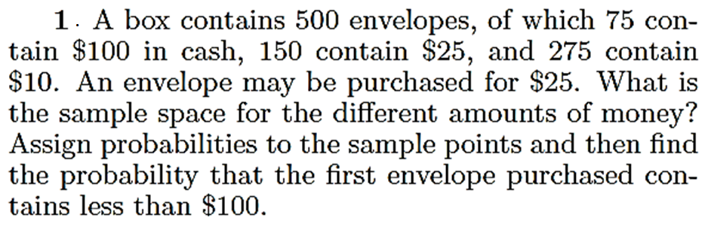
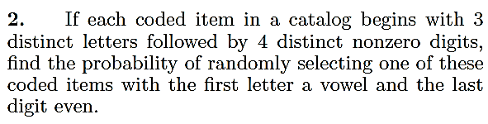
Exercise

Slide 35
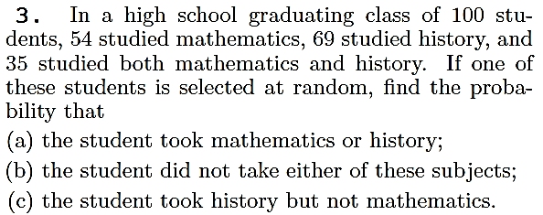
Exercise

Slide 36
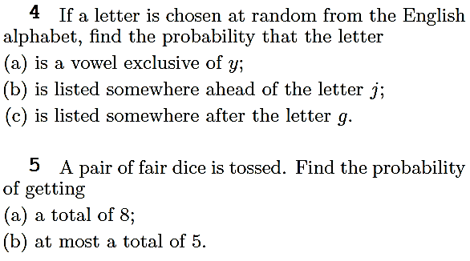
Exercise

Slide 37
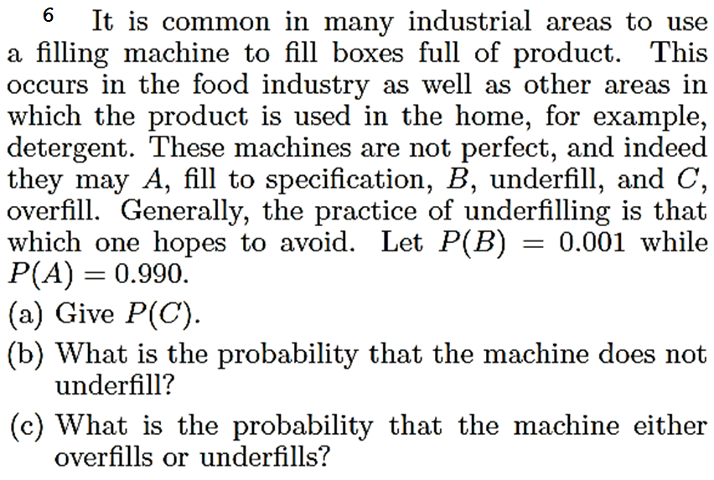
Exercise

Slide 38
Conditional Probability

Slide 39
The probability of an event B occurring when it is known that some event A has occurred is called a conditional probability and is denoted by P(B|A). The
symbol P (B | A) is usually read "the probability that B occurs given that A occurs"
or simply "the probability of B, given A."

Slide 40
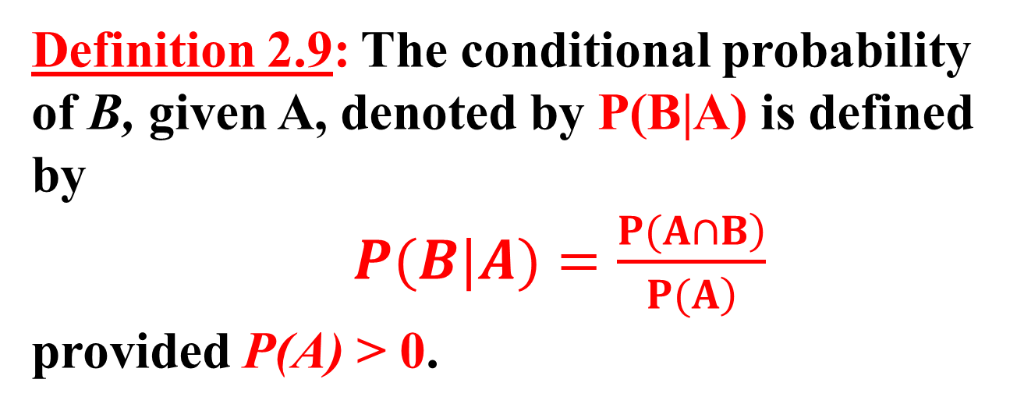
Definition 2.9: The conditional probability of B, given A, denoted by P(B|A) is defined by
$P(B|A)=\frac{\left.P(A∩B\right)}{\left.P(A\right)}$
provided P(A) > 0.

Slide 41
Example:
Suppose that our sample space S is the population of adults in a small town who have completed the requirements for a college degree. We shall categorize them according to gender and employment status. The data are given in the following table.

Slide 43
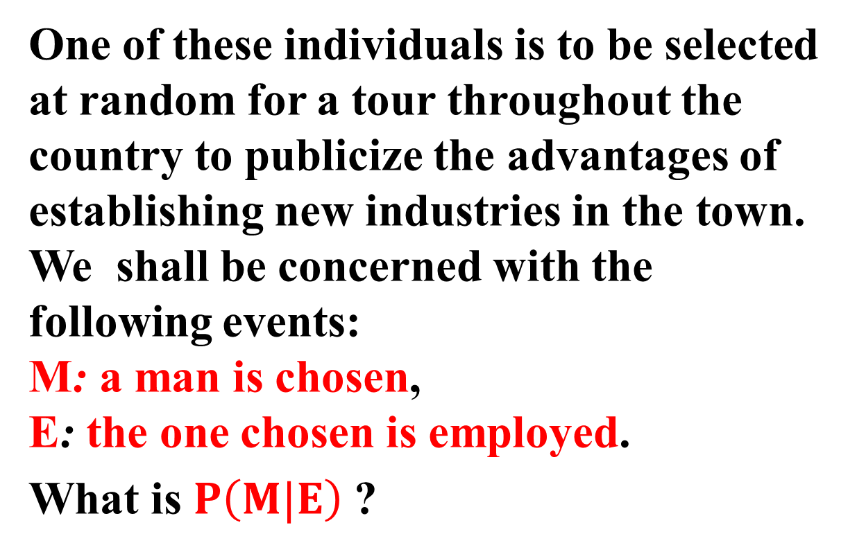
One of these individuals is to be selected at random for a tour throughout the
country to publicize the advantages of establishing new industries in the town. We shall be concerned with the following events:
M: a man is chosen,
E: the one chosen is employed.
What is $P\left(M|E\right)$ ?

Slide 44
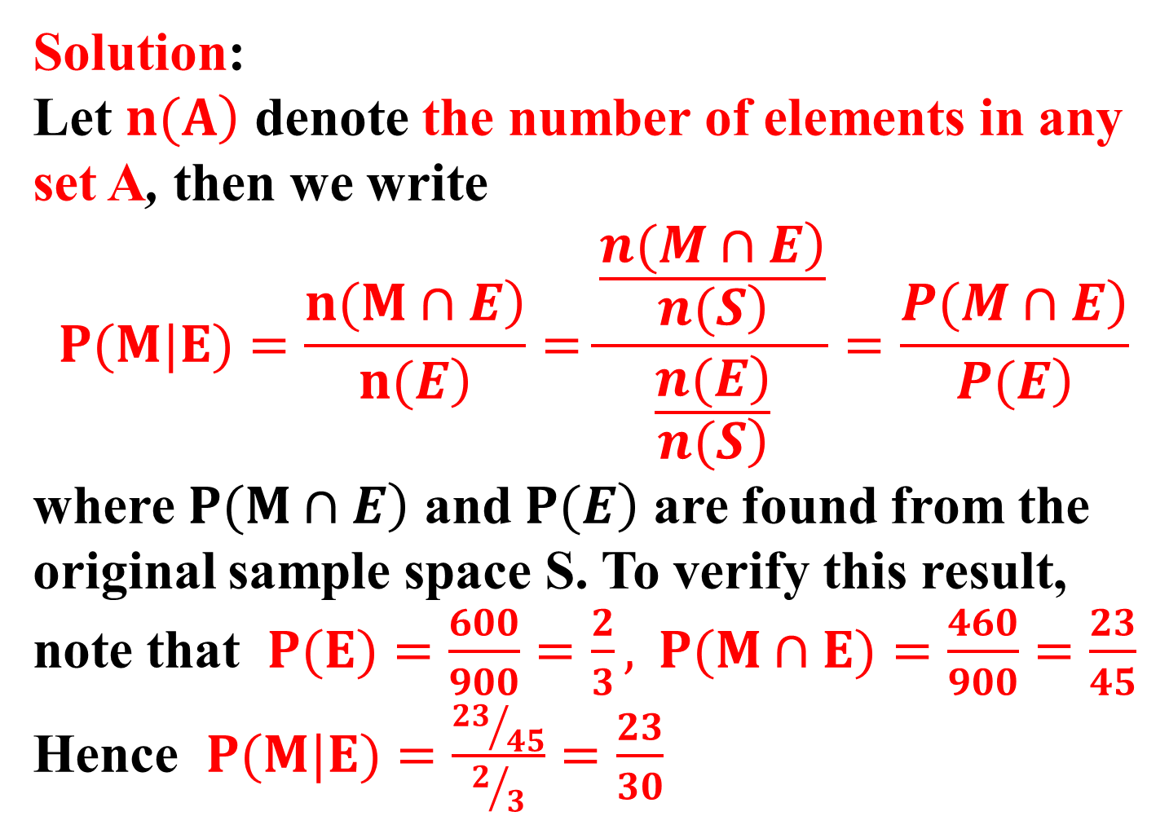
Solution:
Let $\left.n(A\right)$ denote the number of elements in any set A, then we write
$$P(M|E)=\frac{\left.n(M∩E\right)}{\left.n(E\right)}=\frac{\frac{\left.n(M∩E\right)}{\left.n(S\right)}}{\frac{\left.n(E\right)}{\left.n(S\right)}}=\frac{\left.P(M∩E\right)}{\left.P(E\right)}$$
where $\left.P(M∩E\right)$ and $\left.P(E\right)$ are found from the original sample space S. To verify this result, note that $P(E)=\frac{600}{900}=\frac{2}{3}, P(M∩E)=\frac{460}{900}=\frac{23}{45}$
Hence $P(M|E)=\frac{{23}/{45}}{2/3}=\frac{23}{30}$

Slide 45

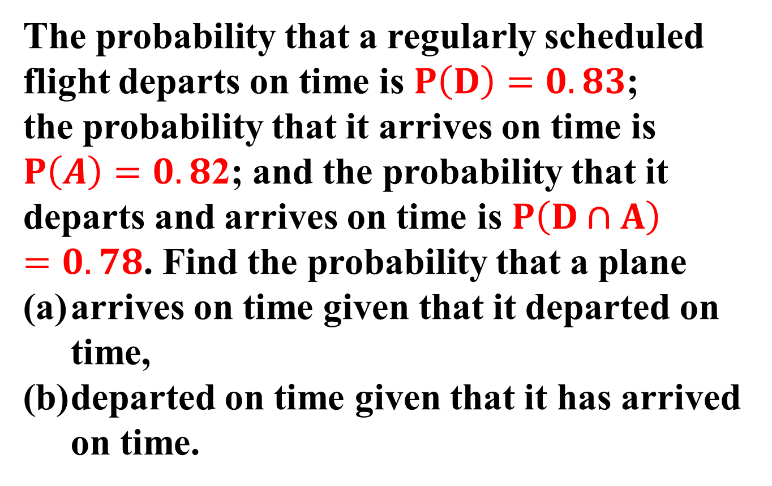
The probability that a regularly scheduled flight departs on time is $P\left(D\right)=0.83$;
the probability that it arrives on time is $P\left(A\right)=0.8$2; and the probability that it
departs and arrives on time is $P\left(D∩A\right)=0.78$. Find the probability that a plane
arrives on time given that it departed on time,
departed on time given that it has arrived on time.

Slide 46

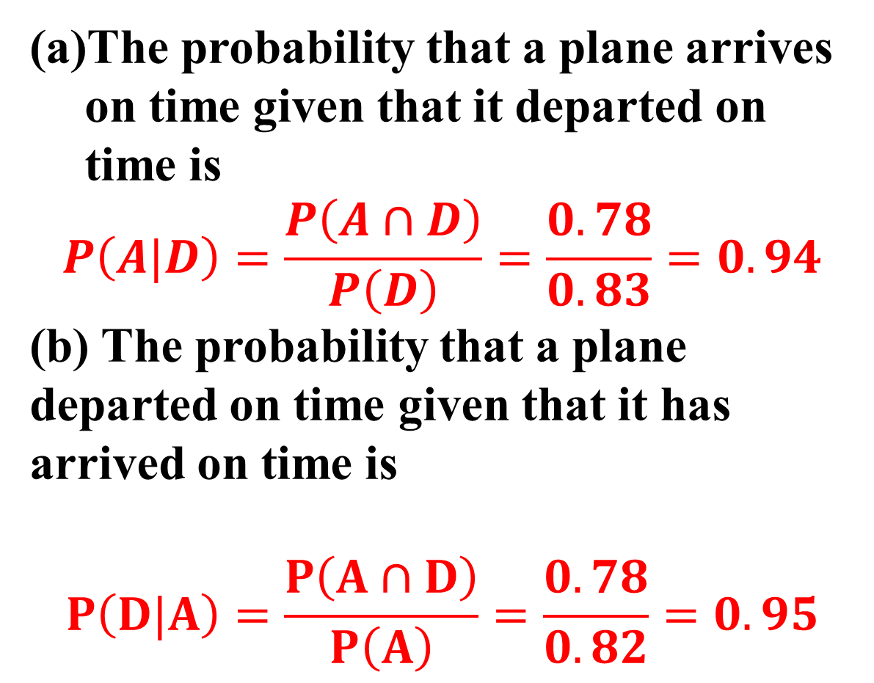
The probability that a plane arrives on time given that it departed on time is
$$P\left(A|D\right)=\frac{P\left(A∩D\right)}{P\left(D\right)}=\frac{0.78}{0.83}=0.94$$
(b) The probability that a plane departed on time given that it has arrived on time is
$$P\left(D|A\right)=\frac{P\left(A∩D\right)}{P\left(A\right)}=\frac{0.78}{0.82}=0.95$$

Slide 47
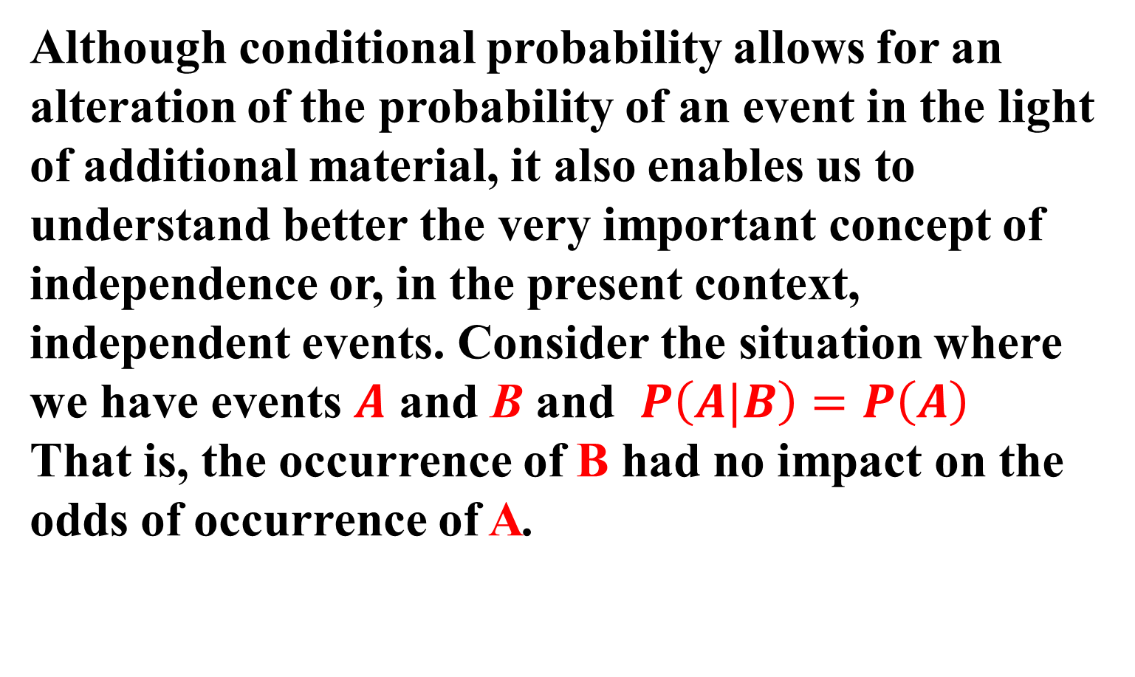
Independent Events :
Although conditional probability allows for an alteration of the probability of an event in the light of additional material, it also enables us to understand better the very important concept of independence or, in the present context, independent events. Consider the situation where we have events $A$ and B and $P\left(A|B\right)=P\left(A\right)$
That is, the occurrence of B had no impact on the odds of occurrence of A.

Slide 48
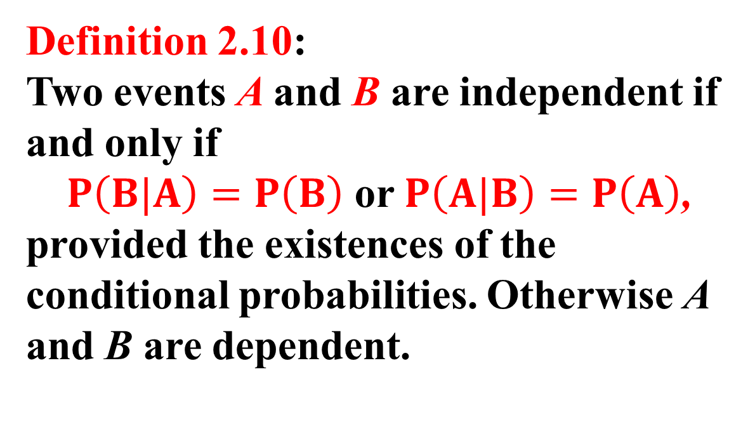
Definition 2.10:
Two events A and B are independent if and only if
$P\left(B|A\right)=P\left(B\right)$ or $P\left(A|B\right)=P\left(A\right)$,
provided the existences of the conditional probabilities. Otherwise A and B are dependent.

Slide 49
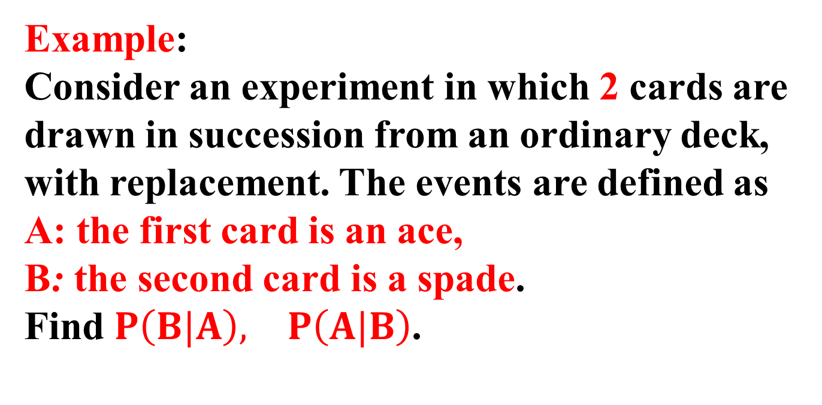
Example:
Consider an experiment in which 2 cards are drawn in succession from an ordinary deck,
with replacement. The events are defined as
A: the first card is an ace,
B: the second card is a spade.
Find $P\left(B|A\right), P\left(A|B\right)$.

Slide 50
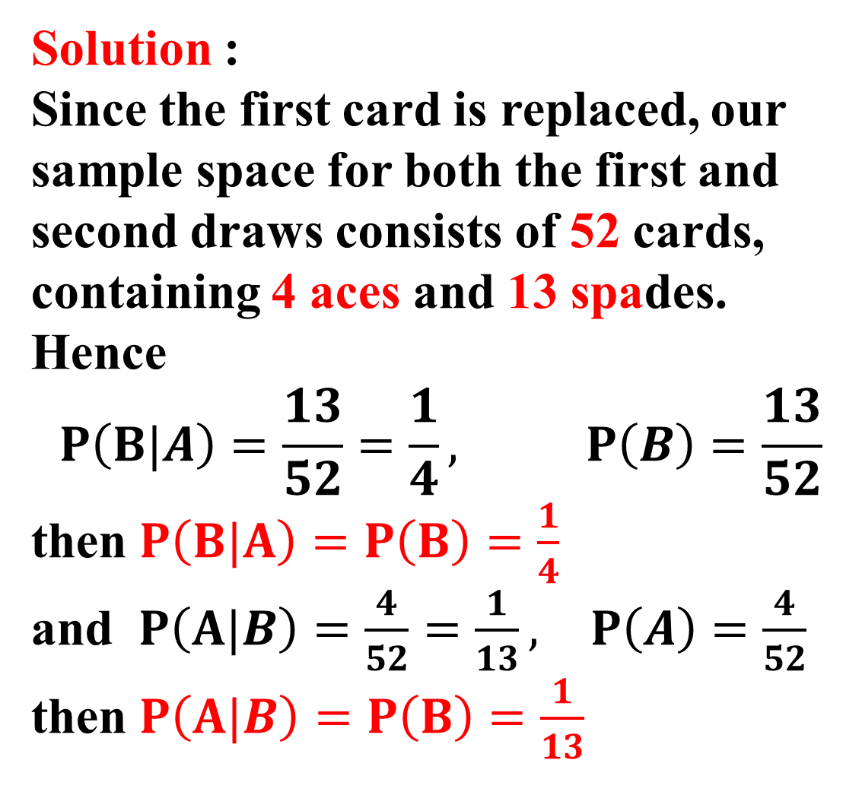
Solution :
Since the first card is replaced, our sample space for both the first and second draws consists of 52 cards,
containing 4 aces and 13 spades. Hence
$$P\left(B|A\right)=\frac{13}{52}=\frac{1}{4}, P\left(B\right)=\frac{13}{52}$$
then $P\left(B|A\right)=P\left(B\right)=\frac{1}{4}$
and $P\left(A|B\right)=\frac{4}{52}=\frac{1}{13}, P\left(A\right)=\frac{4}{52}$
then $P\left(A|B\right)=P\left(B\right)=\frac{1}{13}$

Slide 51
Multiplicative Rules:
Multiplying the formula of Definition 2.9 by P(A), we obtain the following important
multiplicative rule, which enables us to calculate the probability that two events will both occur.

Slide 52
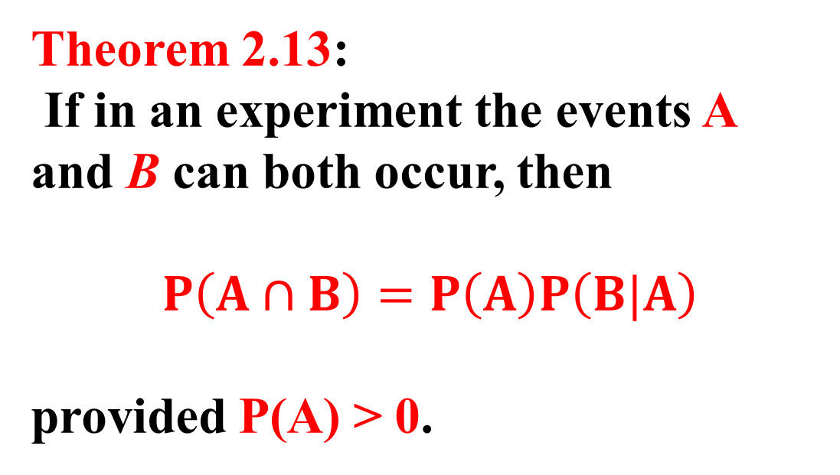
Theorem 2.13:
If in an experiment the events A and B can both occur, then
$$P\left(A∩B\right)=P\left(A\right)P\left(B|A\right)$$
provided P(A) > 0.

Slide 53
Example:
Suppose that we have a fuse box containing 20 fuses, of which 5 are defective. If 2 fuses are selected at random and removed from the box in succession without replacing the first, what is the probability that both fuses are defective?

Slide 54
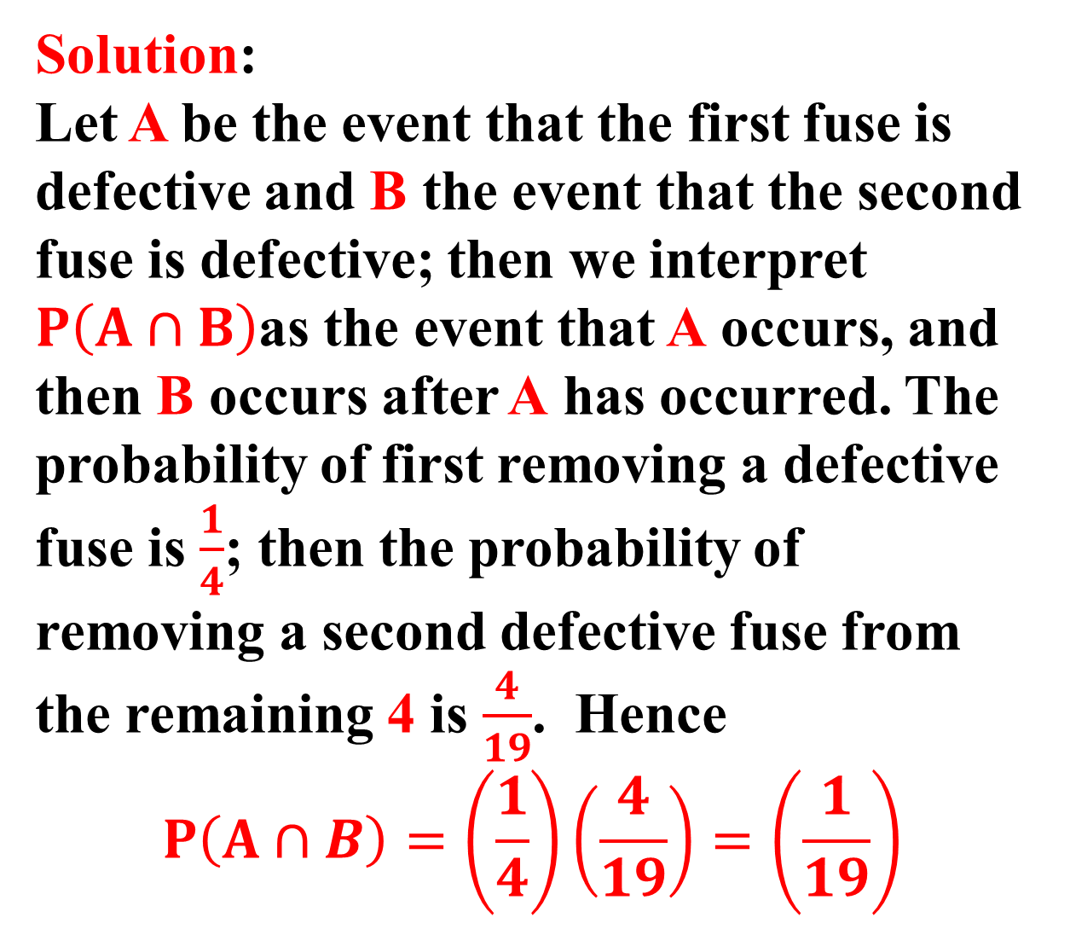
Solution:
Let A be the event that the first fuse is defective and B the event that the second fuse is defective; then we interpret $P\left(A∩B\right)$as the event that A occurs, and then B occurs after A has occurred. The probability of first removing a defective fuse is $\frac{1}{4}$; then the probability of removing a second defective fuse from the remaining 4 is $\frac{4}{19}$. Hence
$$P\left(A∩B\right)=\left(\frac{1}{4}\right)\left(\frac{4}{19}\right)=\left(\frac{1}{19}\right)$$

Slide 55
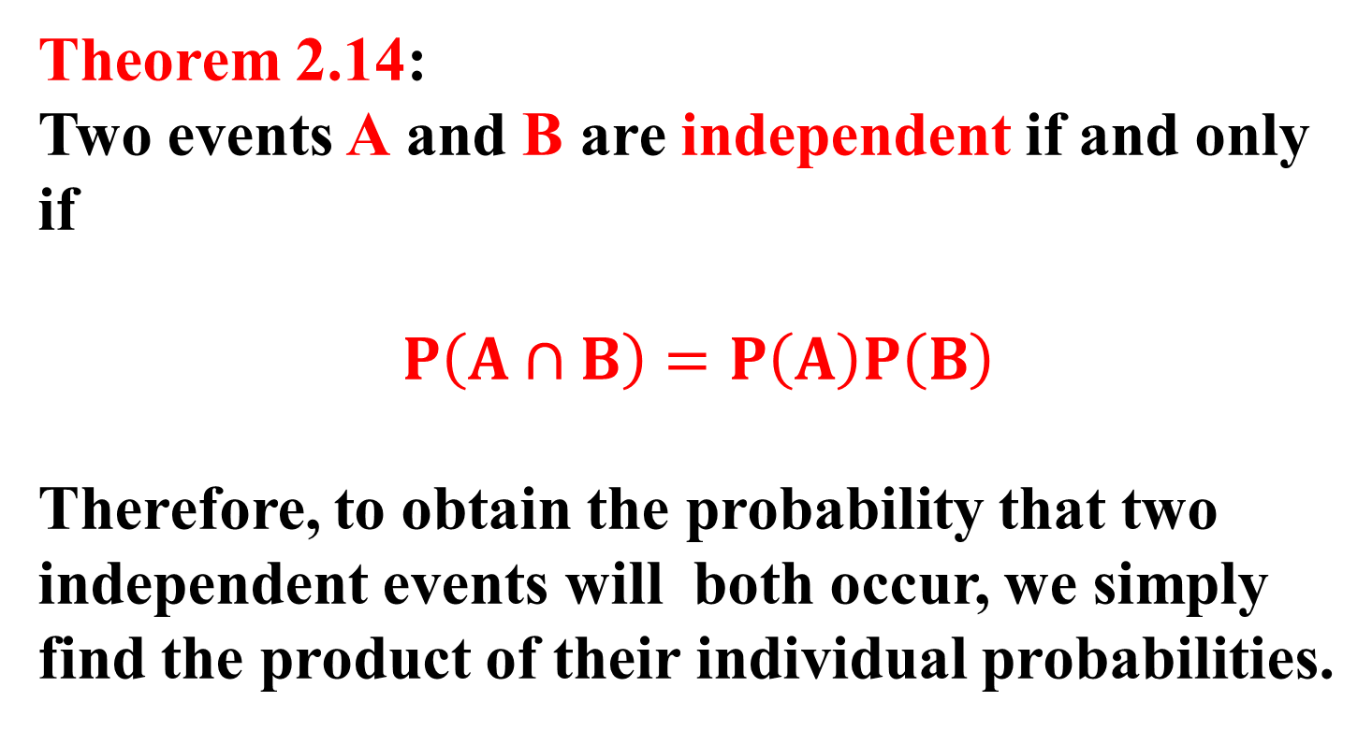
Theorem 2.14:
Two events A and B are independent if and only if
$$P\left(A∩B\right)=P\left(A\right)P\left(B\right)$$
Therefore, to obtain the probability that two independent events will both occur, we simply find the product of their individual probabilities.

Slide 56
Example:
An electrical system consists of four components as illustrated in Figure 1 below. The system works if components A and B work and either of the components C or D work. The reliability (probability of working) of each component is also shown in Figure 1. Find the probability that
the entire system works, and
the component C does not work, given that the entire system works. Assume that four components work independently.

Slide 58
Solution:
In this configuration of the system, A, B, and the subsystem C and D constitute
a serial circuit system, whereas the subsystem C and D itself is a parallel circuit system.
(a) Clearly the probability that the entire system works can be calculated as the following:

Slide 59
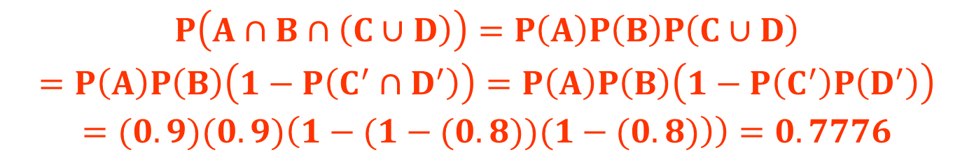
$$\begin{matrix}P\left(A∩B∩\left(C∪D\right)\right)=P\left(A\right)P\left(B\right)P\left(C∪D\right) \\ =P\left(A\right)P\left(B\right)\left(1−P\left(C^{′}∩D^{′}\right)\right)=P\left(A\right)P\left(B\right)\left(1−P\left(C^{′}\right)P\left(D^{′}\right)\right) \\ =(0.9)(0.9)\left(\left.1−(1−(0.8))(1−(0.8)\right)\right)=0.7776\end{matrix}$$
The equalities above hold because of the independence among the four components.

Slide 60
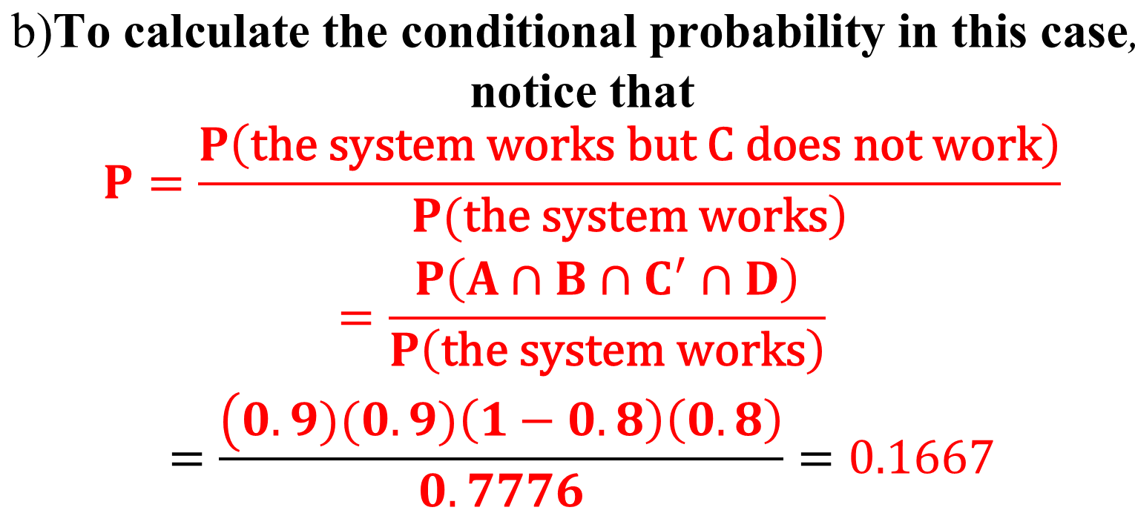
$$\begin{matrix}\text{b}\text{)}\text{To} \text{calculate} \text{the} \text{conditional} \text{probability} \text{in} \text{this} \text{case}\text{, } \\ \text{notice} \text{that} \\ P=\frac{P\left(\text{the} \text{system} \text{works} \text{but} \text{C} \text{does} \text{not} \text{work}\right)}{\left.P(\text{the} \text{system} \text{works}\right)} \\ =\frac{P\left(A∩B∩C^{′}∩D\right)}{P\left(\text{the} \text{system} \text{works}\right)} \\ =\frac{\left(0.9)(0.9)\left(1−0.8\right)\left(0.8\right)\right.}{0.7776}=0.1667\end{matrix}$$

Slide 61
Conditional Probability - Bayes’ Rule

Slide 62
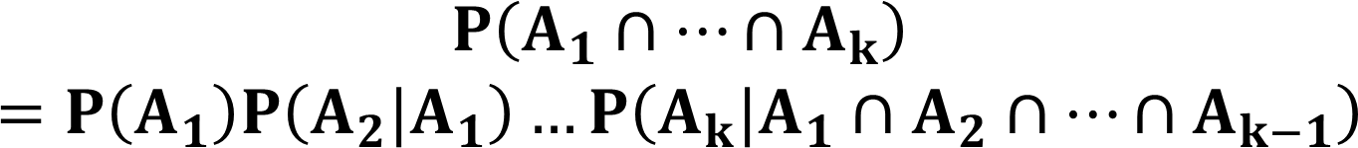
Theorem 2.15:
If, in an experiment, the events $A_{1},A_{2},…,A_{k}$ can occur, then
If the events $A_{1},A_{2},…,A_{k}$ are independent, then
$$P\left(A_{1}∩…∩A_{k}\right)=P\left(A_{1}\right)P\left(A_{2}\right)…P\left(A_{k}\right)$$

Slide 63
Example:
Three cards are drawn in succession, without replacement, from an ordinary deck of playing cards. Find the probability that the event $P\left(A_{1}∩A_{2}∩A_{3}\right)$ occurs, where
$A_{1}$ is the event that the first card is a red ace, $A_{2}$ is the event that the second card
is a 10 or a jack, and $A_{3}$ is the event that the third card is greater than 3 but less
than 7.

Slide 64
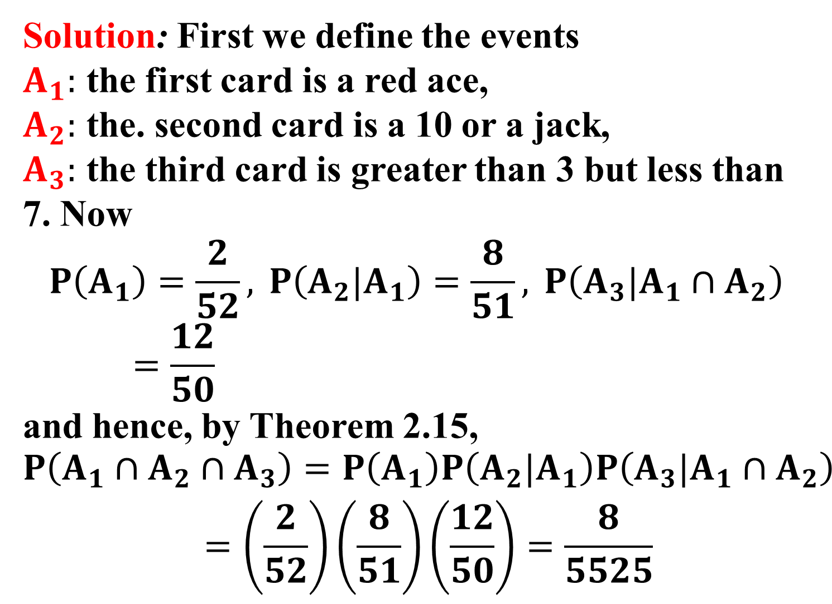
Solution: First we define the events
$A_{1}:$ the first card is a red ace,
$A_{2}:$ the. second card is a 10 or a jack,
$A_{3}:$ the third card is greater than 3 but less than 7. Now
$$P\left(A_{1}\right)=\frac{2}{52}, P\left(A_{2}|A_{1}\right)=\frac{8}{51}, P\left(A_{3}|A_{1}∩A_{2}\right)=\frac{12}{50}$$
and hence, by Theorem 2.15,
$$\begin{matrix}P\left(A_{1}∩A_{2}∩A_{3}\right)=P\left(A_{1}\right)P\left(A_{2}|A_{1}\right)P\left(A_{3}|A_{1}∩A_{2}\right) \\ =\left(\frac{2}{52}\right)\left(\frac{8}{51}\right)\left(\frac{12}{50}\right)=\frac{8}{5525}\end{matrix}$$

Slide 65
Bayes’Rule:
Consider the following figure

Slide 66
Referring to Figure 2, we can write A as the union of the two mutually exclusive events$E∩A$ and $E^{′}∩A\text{.}$ Hence
$$A=\left(E∩A\right)∪\left(E^{′}∩A\right)$$
and by additive rule and multiplicative rule, we can write
$$\begin{matrix}P(A)=P\left[\left(E∩A\right)∪\left(E^{′}∩A\right)\right] \\ \text{= }P\left(E∩A\right)+P\left(E^{′}∩A\right) \\ =P\left(E\right)P\left(A|E\right)+P\left(E^{′}\right)P\left(A|E^{′}\right) \end{matrix}$$

Slide 67
A generalization of the foregoing illustration to the case where the sample space is partitioned into k subsets is covered by the following theorem, sometimes called the theorem of total probability or the rule of elimination.

Slide 68
Theorem 2.16:
If, the events $B_{1},B_{2},…,B_{k}$ constitute a partition of the sample space S such that
$$P\left(B_{i}\right)≠0 \text{for} i=1,2,…,k$$
then for any event A of S,
$P\left(A\right)=\sum_{i=1}^{k}{P\left(B_{i}∩A\right)}=\sum_{i=1}^{k}{P\left(B_{i}\right)P\left(A|B_{i}\right)}$.

Slide 70
Proof:
Consider the Venn diagram of the figure 3. The events A is seen to be the union of the mutually exclusive events
$$B_{1}∩A, B_{2}∩A,…,B_{k}∩A$$
that is
$$A=\left(B_{1}∩A\right)∪\left(B_{2}∩A\right)∪…∪\left(B_{k}∩A\right)$$
Using theorem 2.10 (additive rule) and theorem 2.13 (multiplicative rule) we have

Slide 71
$$\begin{matrix}P\left(A\right)=P\left[\left(B_{1}∩A\right)∪\left(B_{2}∩A\right)∪…∪\left(B_{k}∩A\right)\right] \\ =P\left(B_{1}∩A\right)+P\left(B_{2}∩A\right)+…+P\left(B_{k}∩A\right) \\ =\sum_{i=1}^{k}{P\left(B_{i}∩A\right)}=\sum_{i=1}^{k}{P\left(B_{i}\right)P\left(A|B_{i}\right)}\end{matrix}$$

Slide 72
Example:
In certain assembly plant In a certain assembly plant, three machines, $B_{1},B_{2},B_{3}$, make 30%, 45%, and 25%, respectively, of the products. It is known from past experience that 2%, 3%,
and 2% of the products made by each machine, respectively, are defective. Now, suppose that a finished product is randomly selected. What is the probability that it is defective?

Slide 73
Solution:
Consider the following events:
A: the product, is defective,
$B_{1}$: the product is made by machine $B_{1}$,
$B_{2}$: the product is made by machine $B_{2}$,
$B_{3}$: product is made by machine $B_{3}$.
Applying the rule of elimination, we can write
$$P\left(A\right)=P\left(B_{1}\right)P\left(A|B_{1}\right)+P\left(B_{2}\right)P\left(A|B_{2}\right)+P\left(B_{3}\right)P\left(A|B_{3}\right)$$

Slide 75
Referring to the tree diagram of Figure 4, we find that the three branches give
the probabilities
$P\left(B_{1}\right)P\left(A|B_{1}\right)$= (0.3) (0.02) = 0.006.
$P\left(B_{2}\right)P\left(A|B_{2}\right)$= (0.45)(0.03) = 0.0135,
$P\left(B_{3}\right)P\left(A|B_{3}\right)$= (0.25)(0.02) = 0.005,
and hence
$P\left(A\right)$= 0.006 + 0.0135 + 0.005 = 0.0245.

Slide 76
Theorem 2.17: (Bayes' Rule)
If the events $B_{1},B_{2},…,B_{k}$constitute a partition of the sample space S such that $P\left(B_{i}\right)≠0 \text{for} i=1,2,…,k,$then for any event A in S such that $P\left(A\right)≠0\text{,}$
$$P\left(B_{r}|A\right)=\frac{P\left(B_{r}∩A\right)}{\sum_{i=1}^{k}{P\left(B_{i}∩A\right)}}$$
$$=\frac{P\left(B_{r}\right)P\left(A|B_{r}\right)}{\sum_{i=1}^{k}{P\left(B_{i}\right)P\left(A|B_{i}\right)}}$$
$$\text{for} r=1,2,…,k$$

Slide 77
Proof:
By the: definition of conditional probability,
$$P\left(B_{r}|A\right)=\frac{P\left(B_{r}∩A\right)}{P\left(A\right)}$$
and then using Theorem 2.16 in the denominator, we have
$$P\left(B_{r}|A\right)=\frac{P\left(B_{r}∩A\right)}{\sum_{i=1}^{k}{P\left(B_{i}∩A\right)}}$$

Slide 78
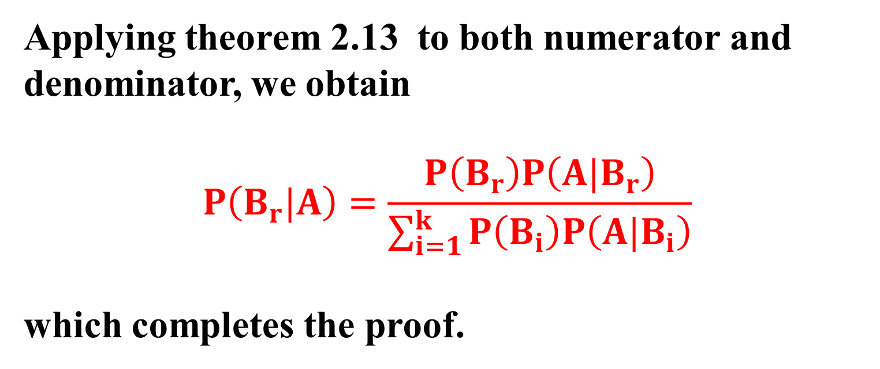
Applying theorem 2.13 to both numerator and denominator, we obtain
$$P\left(B_{r}|A\right)=\frac{P\left(B_{r}\right)P\left(A|B_{r}\right)}{\sum_{i=1}^{k}{P\left(B_{i}\right)P\left(A|B_{i}\right)}}$$
which completes the proof.

Slide 79
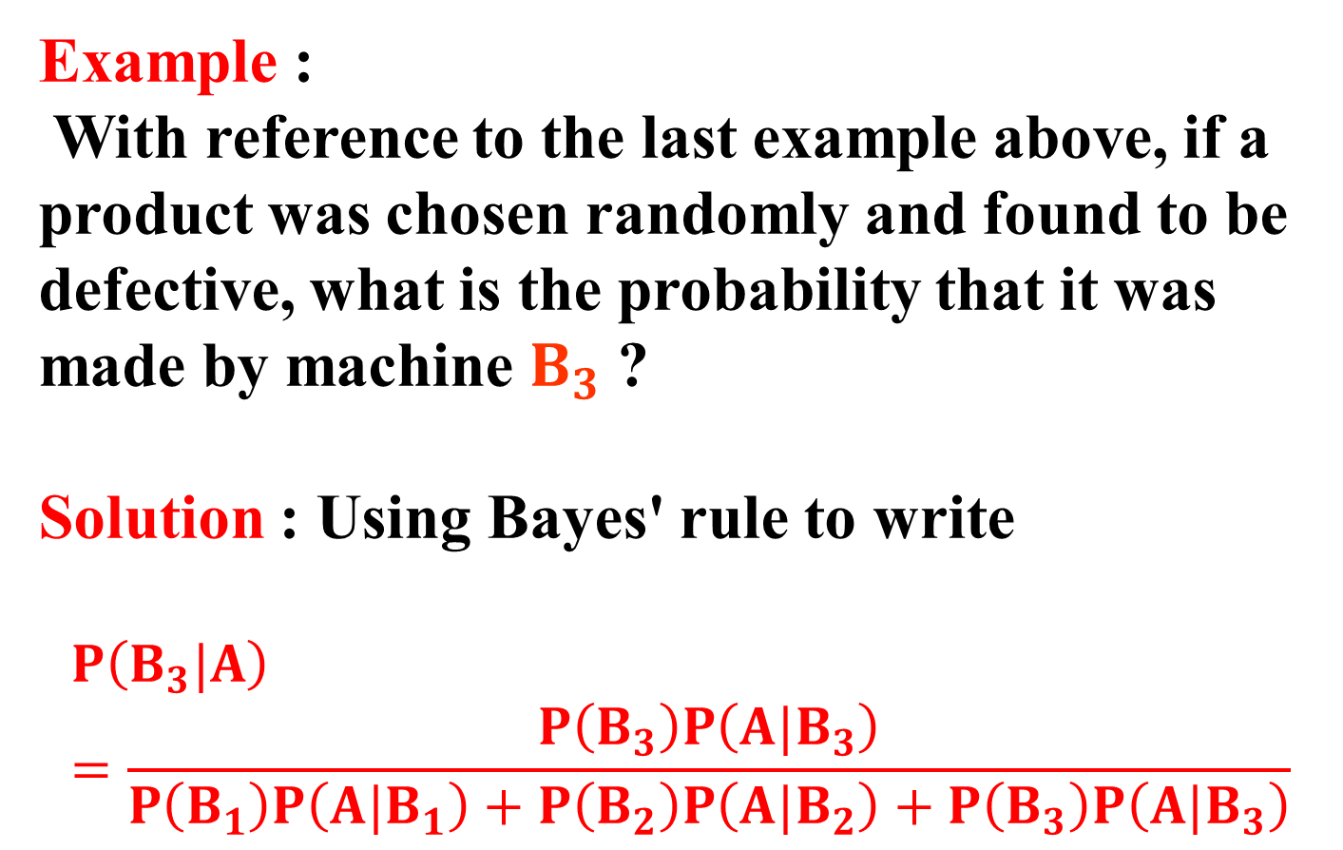
Example :
With reference to the last example above, if a product was chosen randomly and found to be defective, what is the probability that it was made by machine $B_{3}$ ?
Solution : Using Bayes' rule to write
$$P\left(B_{3}|A\right)=\frac{P\left(B_{3}\right)P\left(A|B_{3}\right)}{P\left(B_{1}\right)P\left(A|B_{1}\right)+P\left(B_{2}\right)P\left(A|B_{2}\right)+P\left(B_{3}\right)P\left(A|B_{3}\right)}$$

Slide 80
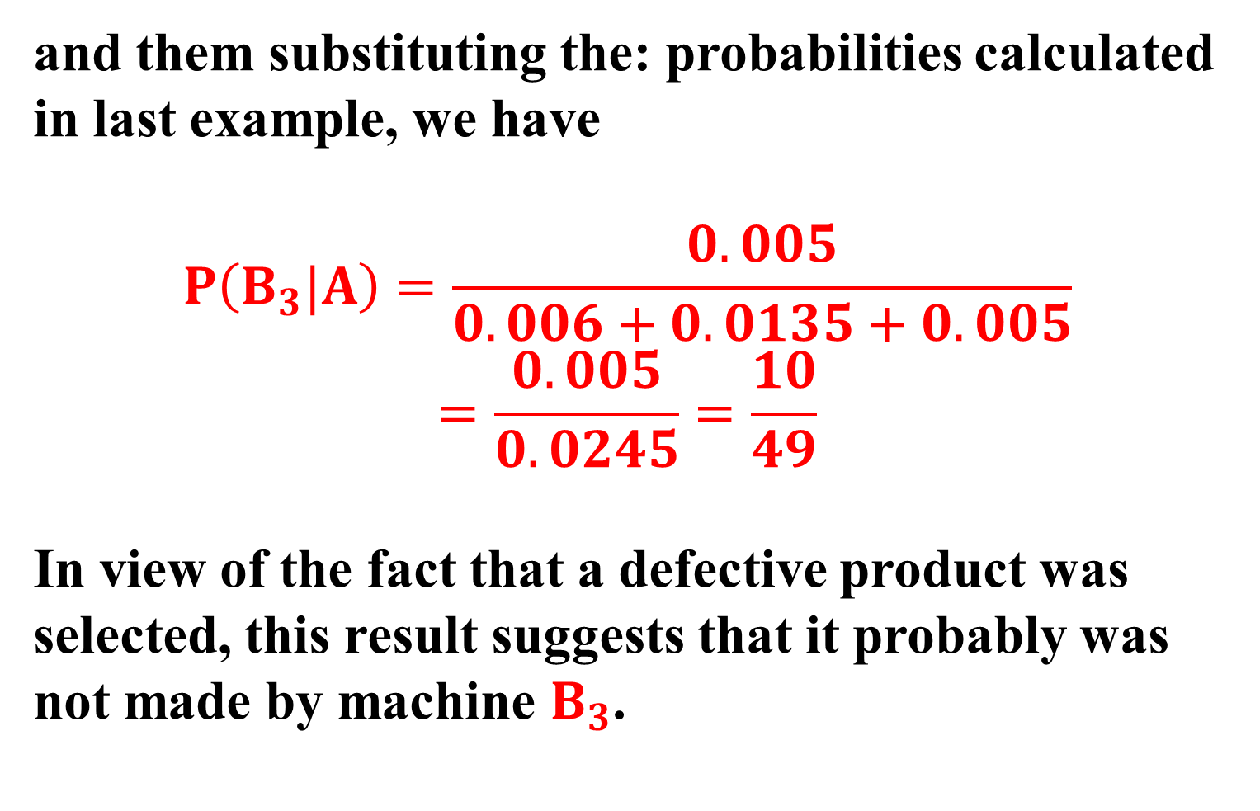
and them substituting the: probabilities calculated in last example, we have
$$P\left(B_{3}|A\right)=\frac{0.005}{0.006+0.0135+0.005}$$
$$=\frac{0.005}{0.0245}=\frac{10}{49}$$
In view of the fact that a defective product was selected, this result suggests that it probably was not made by machine $B_{3}$.

Slide 81
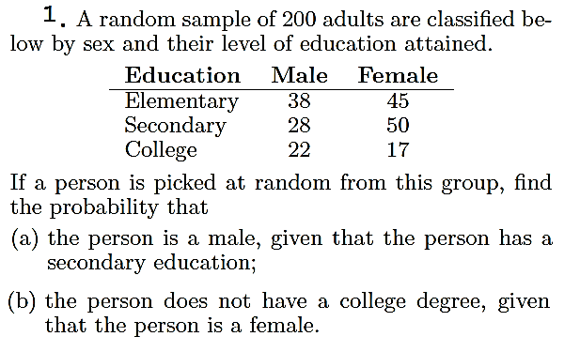
Exercise

Slide 82
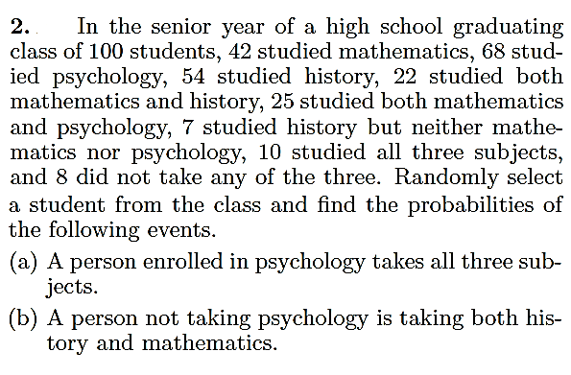
Exercise

Slide 83
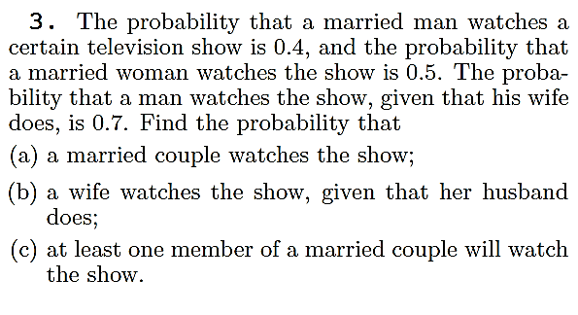
Exercise

Slide 84
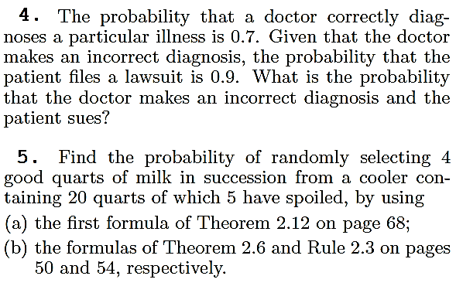
Exercise

Slide 85
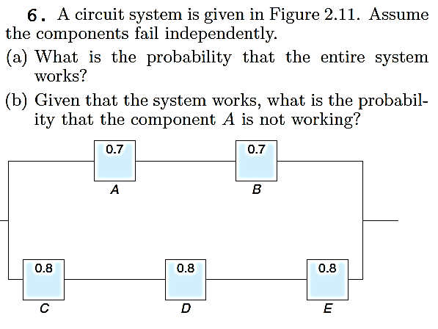
Exercise

